Slide 1
From 0 to 60 with VSTS, TFS and Azure
Principal Expert Microsoft @ Ordina
@wouterdekort www.wouterdekort.com wouter.de.kort@ordina.nl

Slide 2

It’s a wall!
It’s a fan!
It’s a rope!
It’s a spear!

Slide 3
It’s DevOps!
It’s DevOps!
It’s DevOps!
It’s DevOps!

Slide 4
DevOps is the union of people, process, and products to enable continuous delivery of value to our end users.
Donovan Brown
Group Program Manager DevOps

Slide 5






DevOps: the three stage conversation
DEV
OPS
1
People
2
Process
3
Products

Slide 6
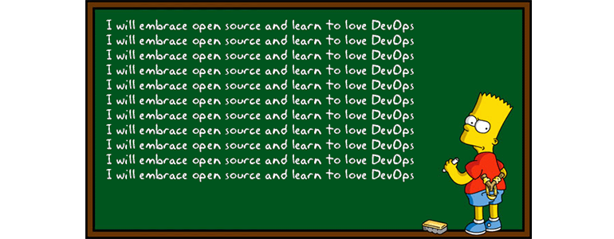
Microsoft determined not to get left behind by DevOps
http://devops.com/features/microsoft-determined-get-left-behind-devops/

Slide 7
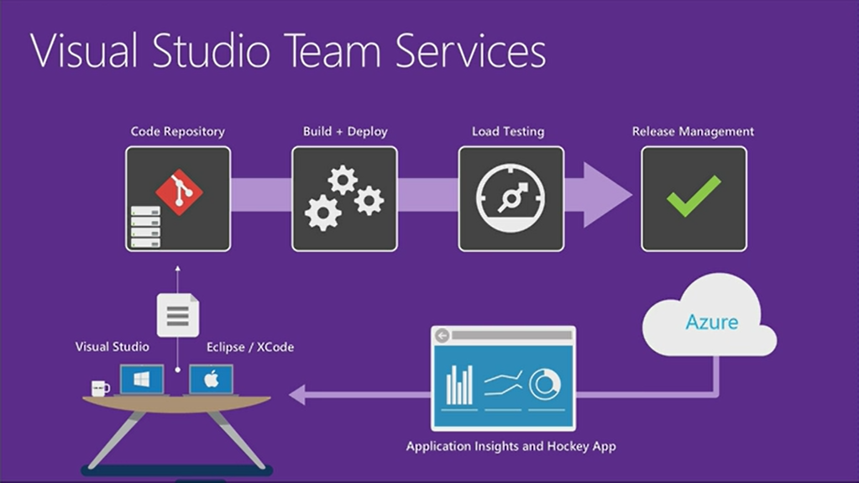

Slide 8
DevOps
1
4
Plan
Monitor + Learn
Development
Production
2
3
Develop + Test
Release

Slide 9
Plan
It starts with an idea – and a plan how to turn this idea into reality …
Project starts
Manage work
Develop + Test
1
Track progress
Plan

Slide 10
Develop + Test
Once the iteration starts, developers turn great ideas into features …
2
Write Code
Unit Testing
Version Control
Build
Build Verification
Release

Slide 11

Release
When all tests pass, the build is deployed to testing environments for each stage in the release process
Cloud
Load Testing
Integration testing
environment
Staging
environment
3
Monitor + Learn
Automated functional testing environment
Pre-production environment

Slide 12
Monitor + Learn
Learn and understand how users use your app, how it reacts and quickly fix issues and bugs
Plan the next iteration
Feedback
Monitor
4

Slide 13
DevOps
1
4
Plan
Monitor + Learn
Development
Production
2
3
Develop + Test
Release

Slide 14


Slide 15

Shameless plug!

Slide 16

The Visual Studio ALM Rangers provide professional guidance, practical experience and gap-filling solutions to the developer community.

Slide 17



@wouterdekort
wouter.de.kort@ordina.nl
http://wouterdekort.com

Slide 18
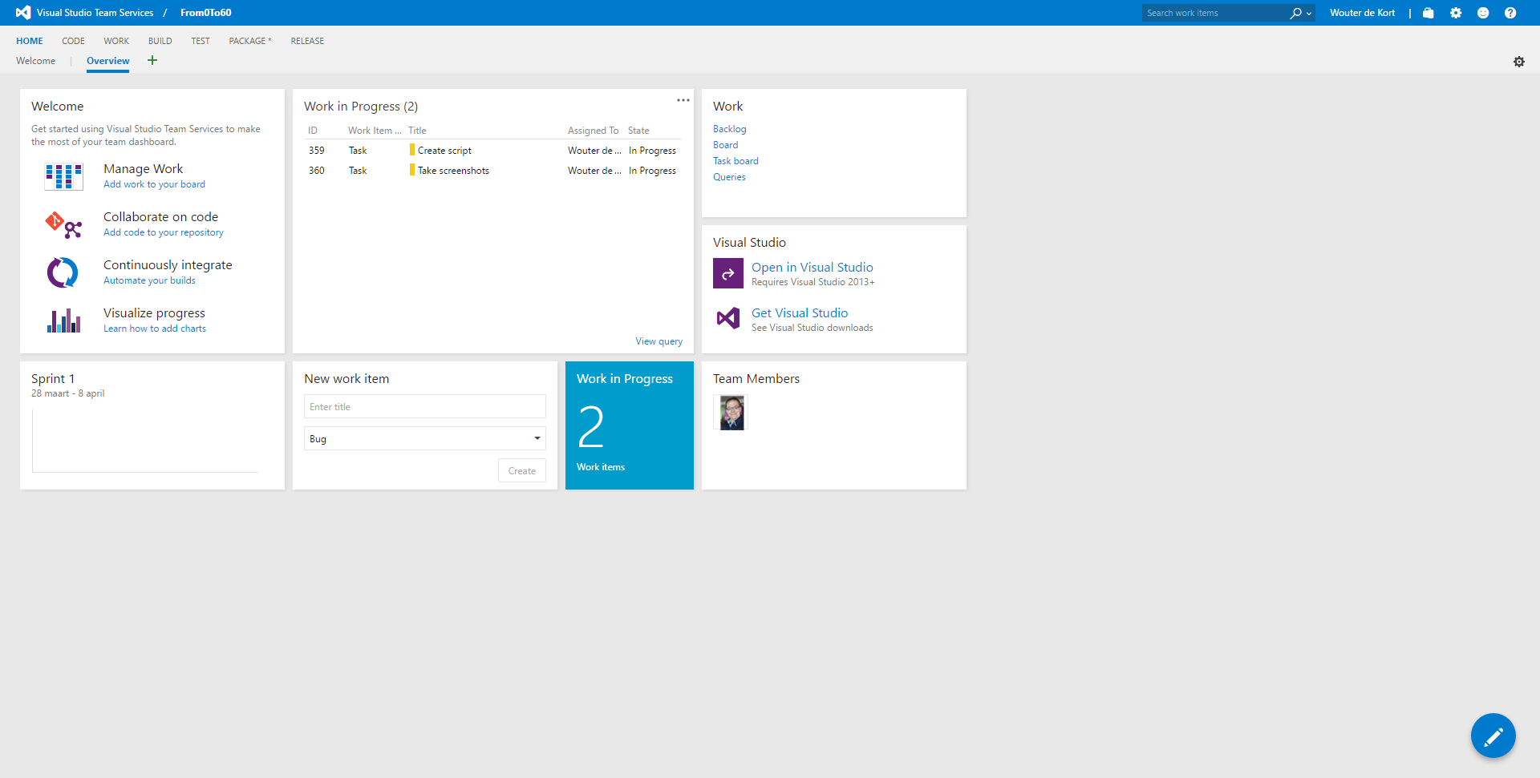

Slide 19
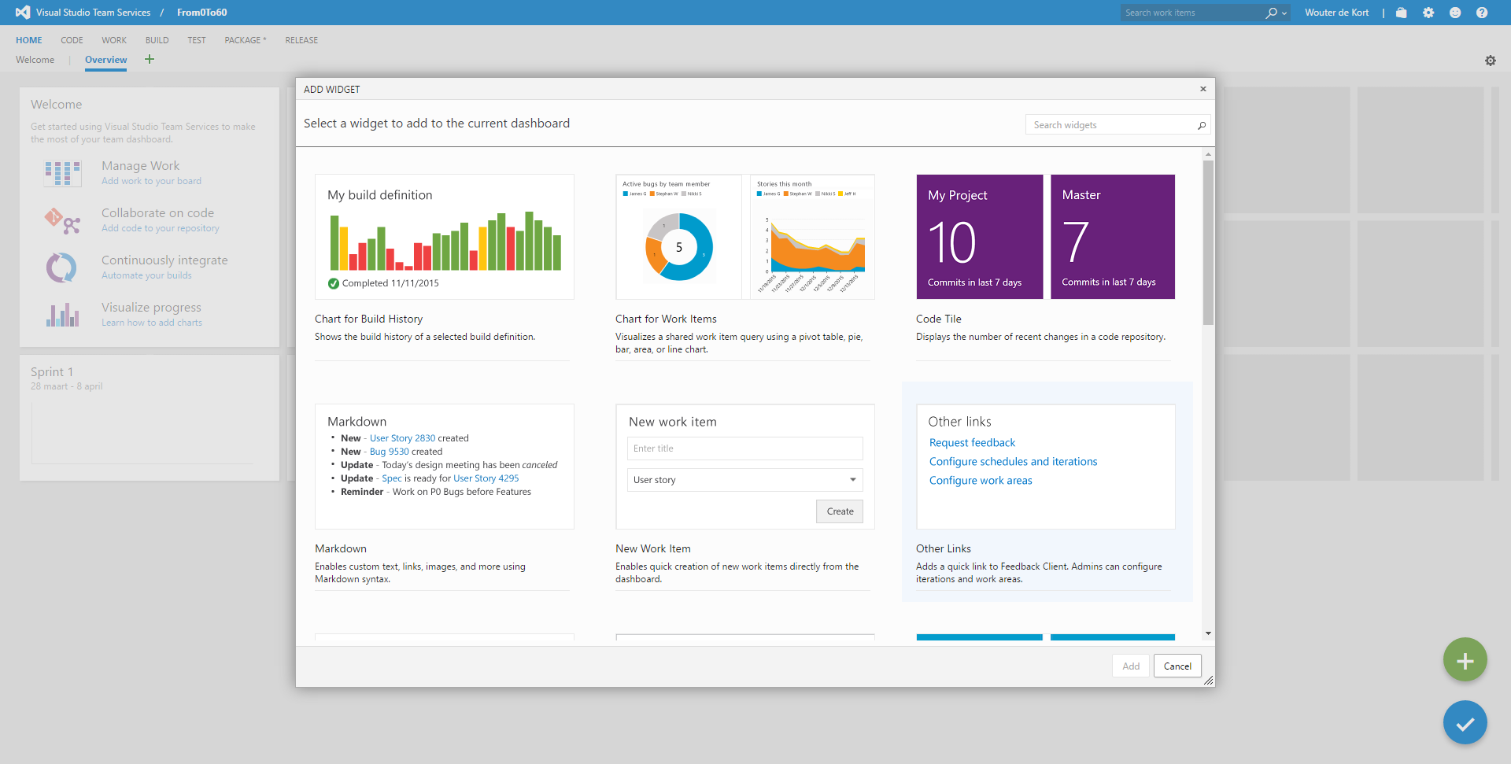

Slide 20
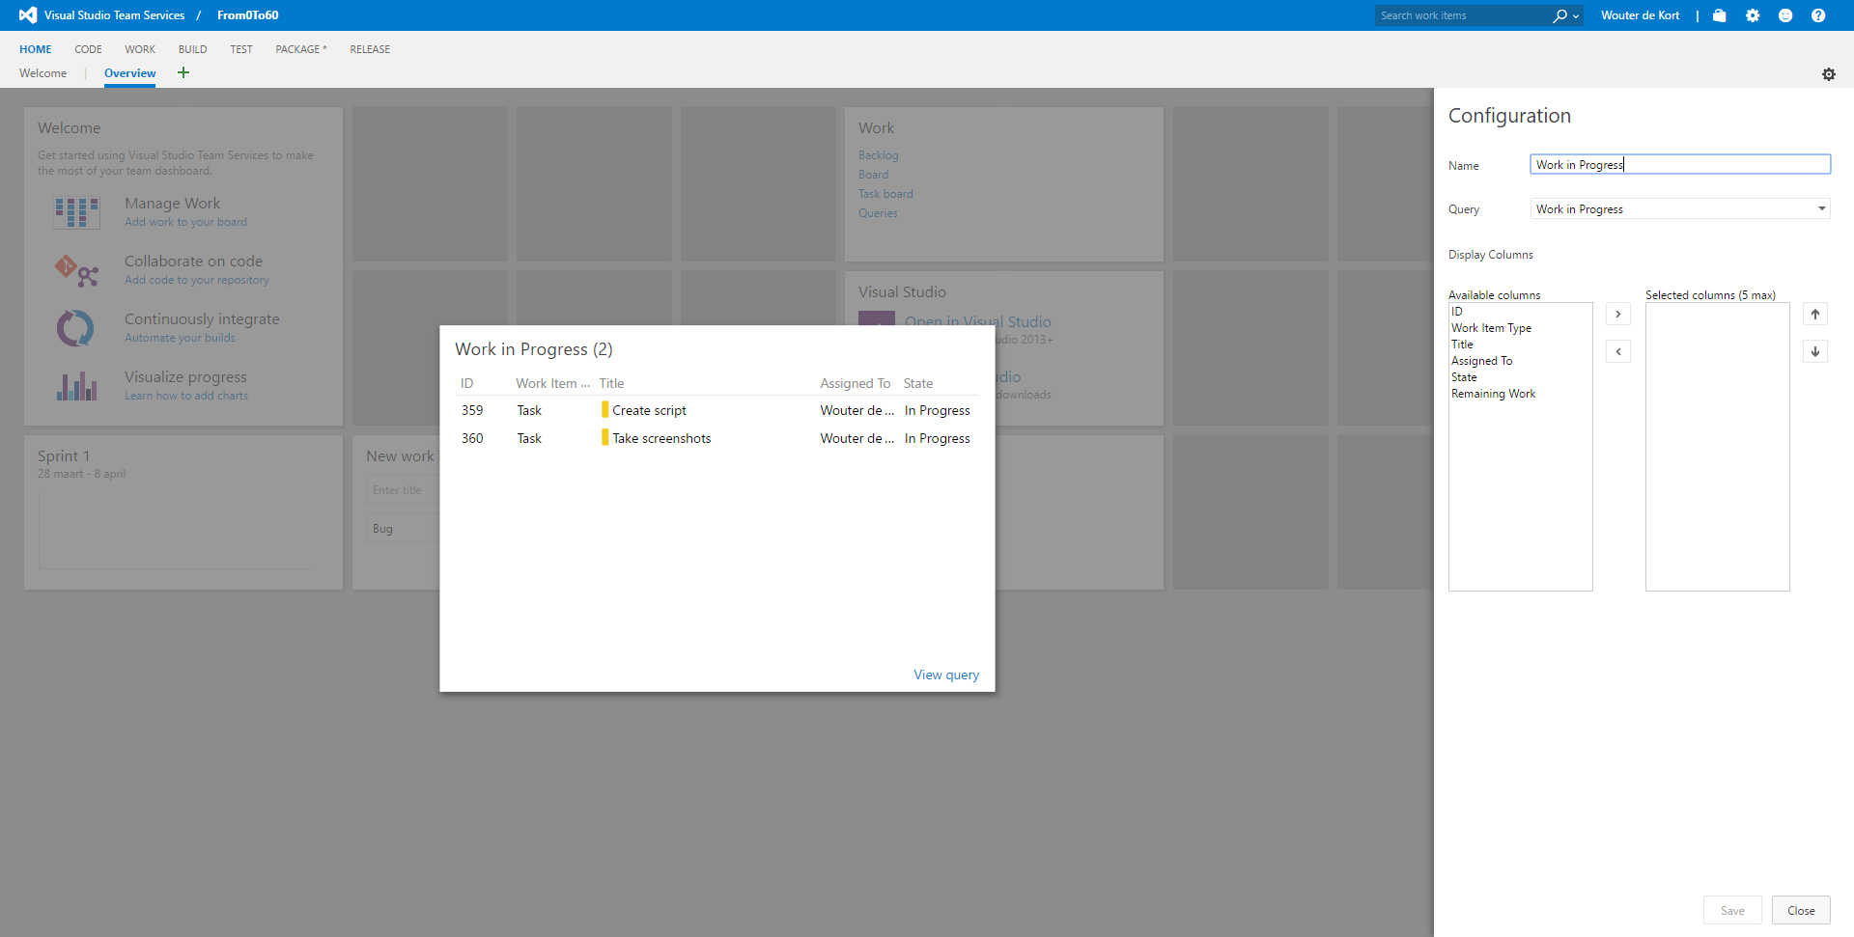

Slide 21
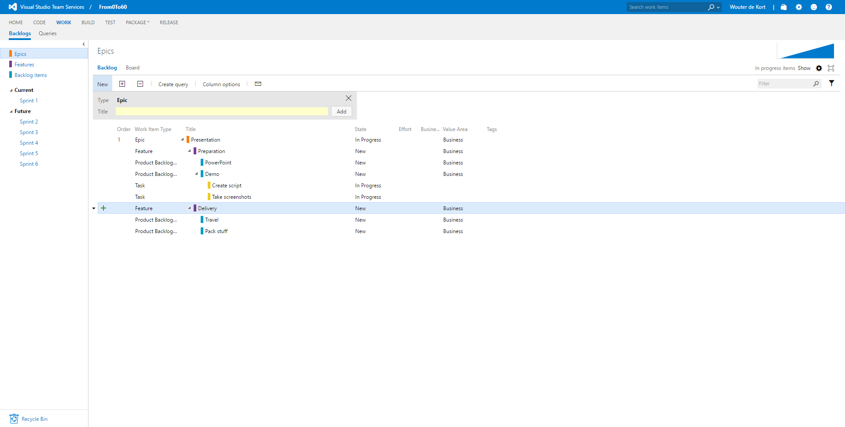

Slide 22
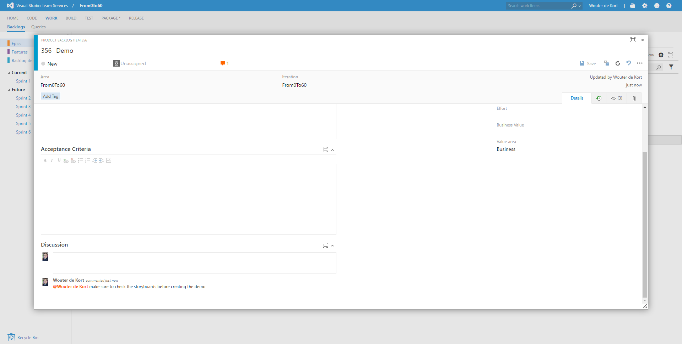

Slide 23
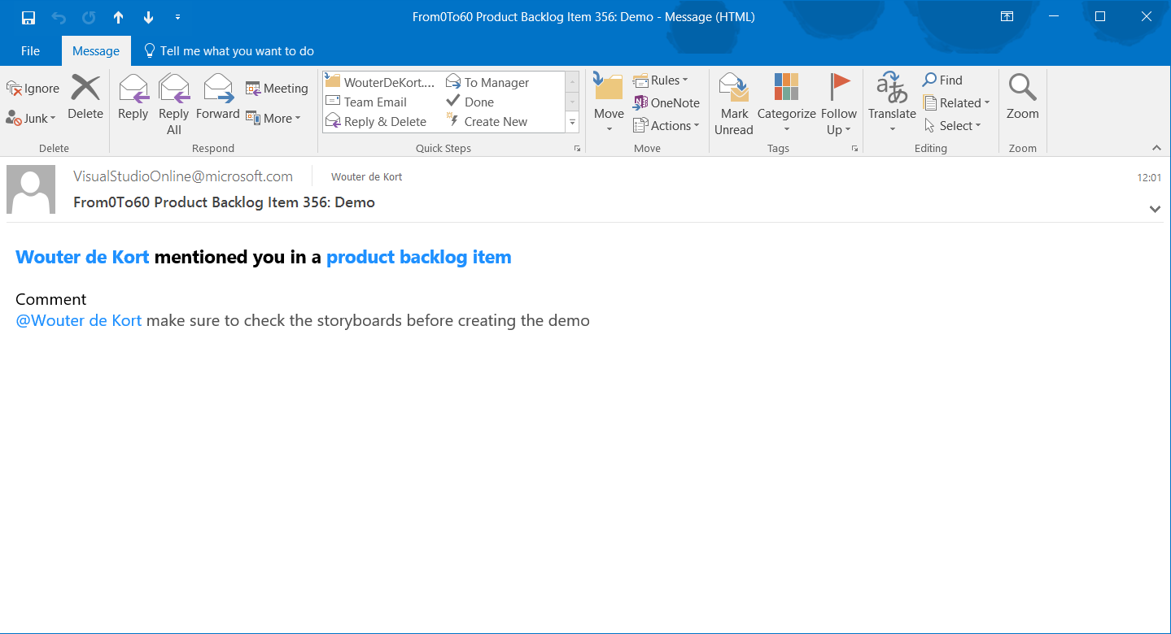

Slide 24
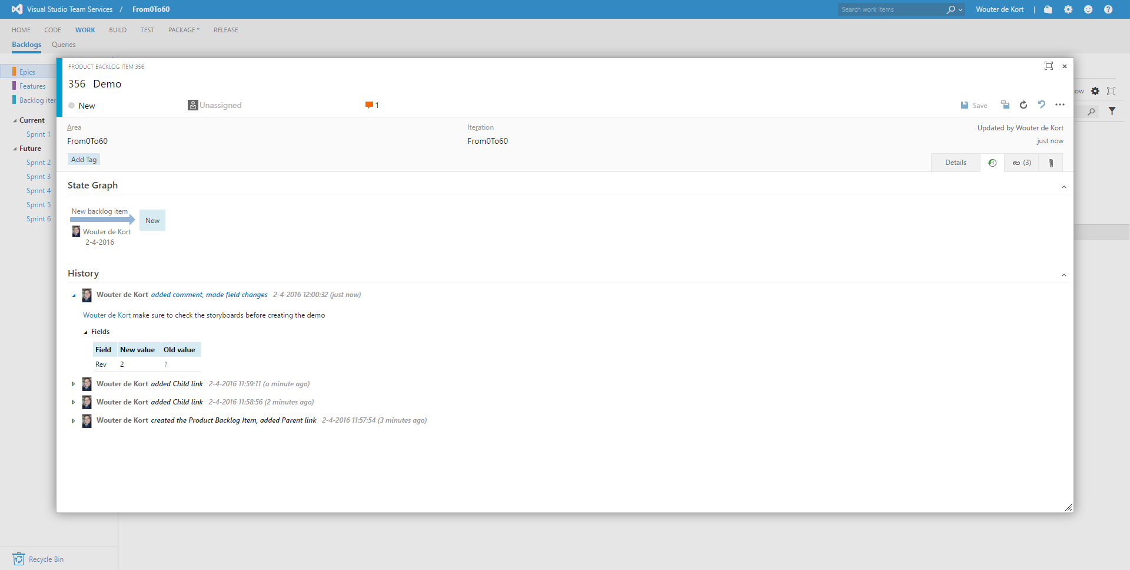

Slide 25
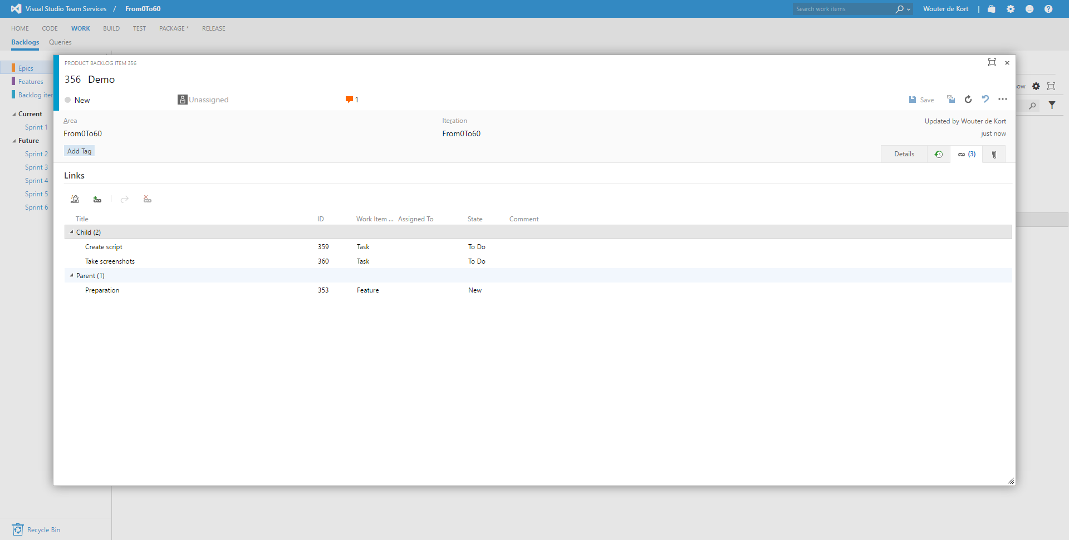

Slide 26
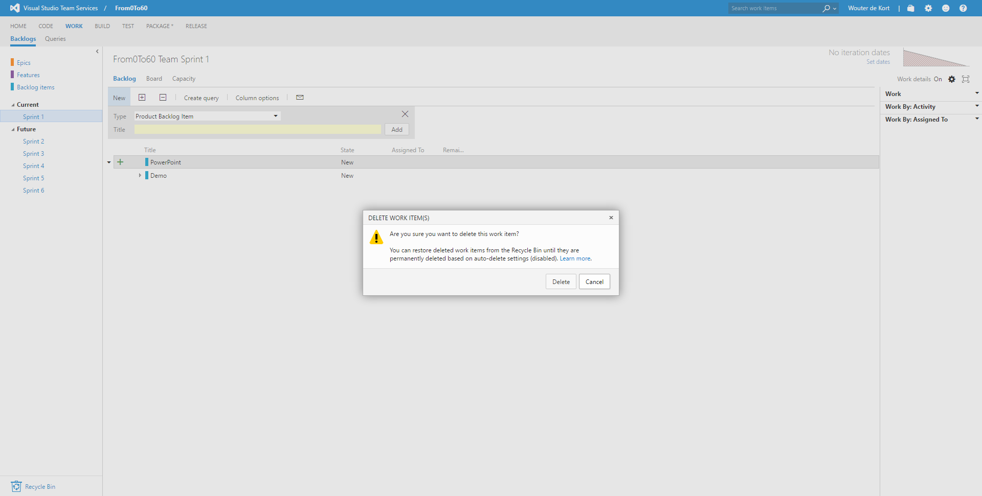

Slide 27
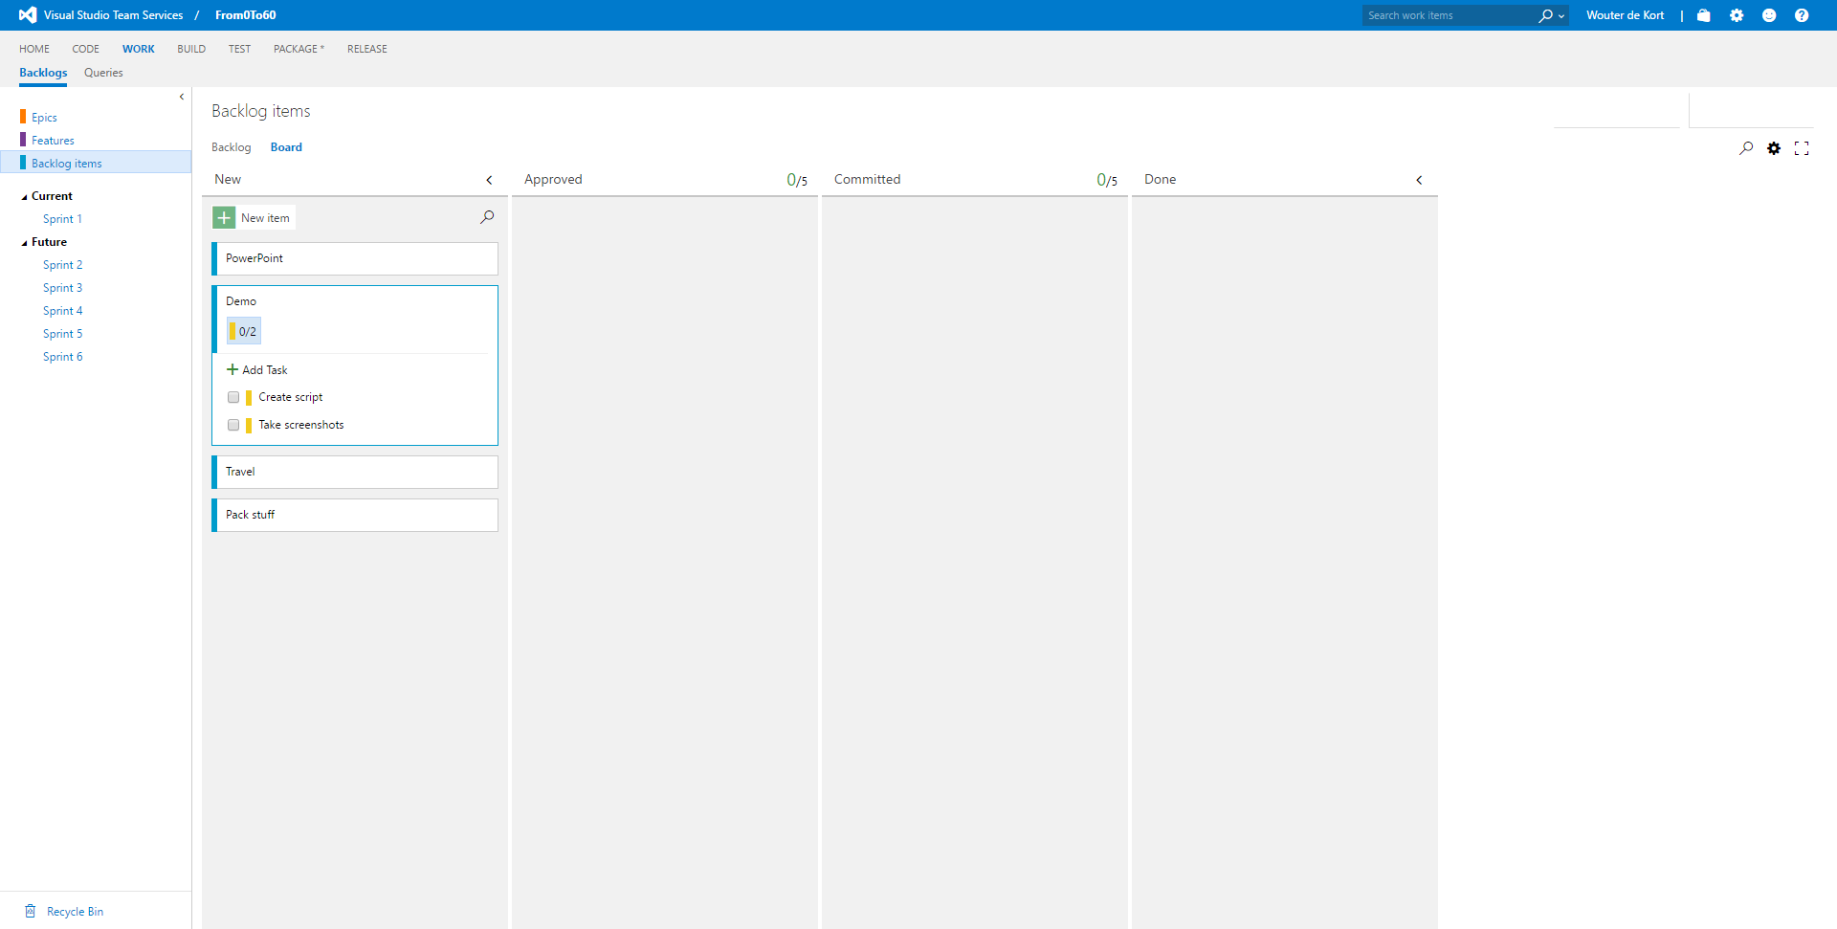

Slide 28
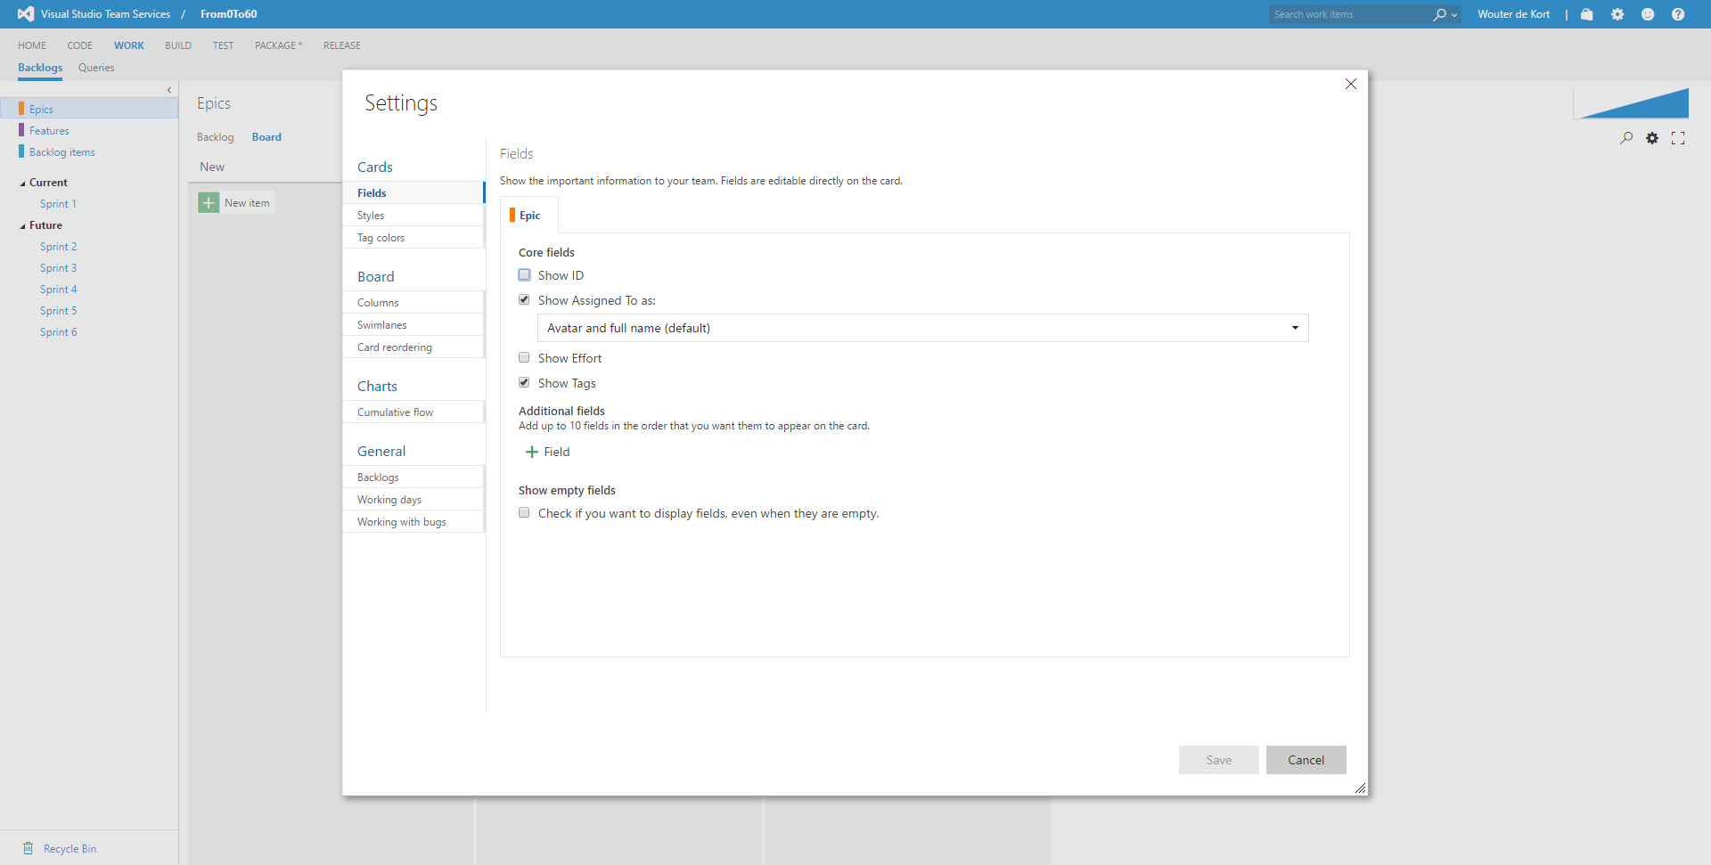

Slide 29
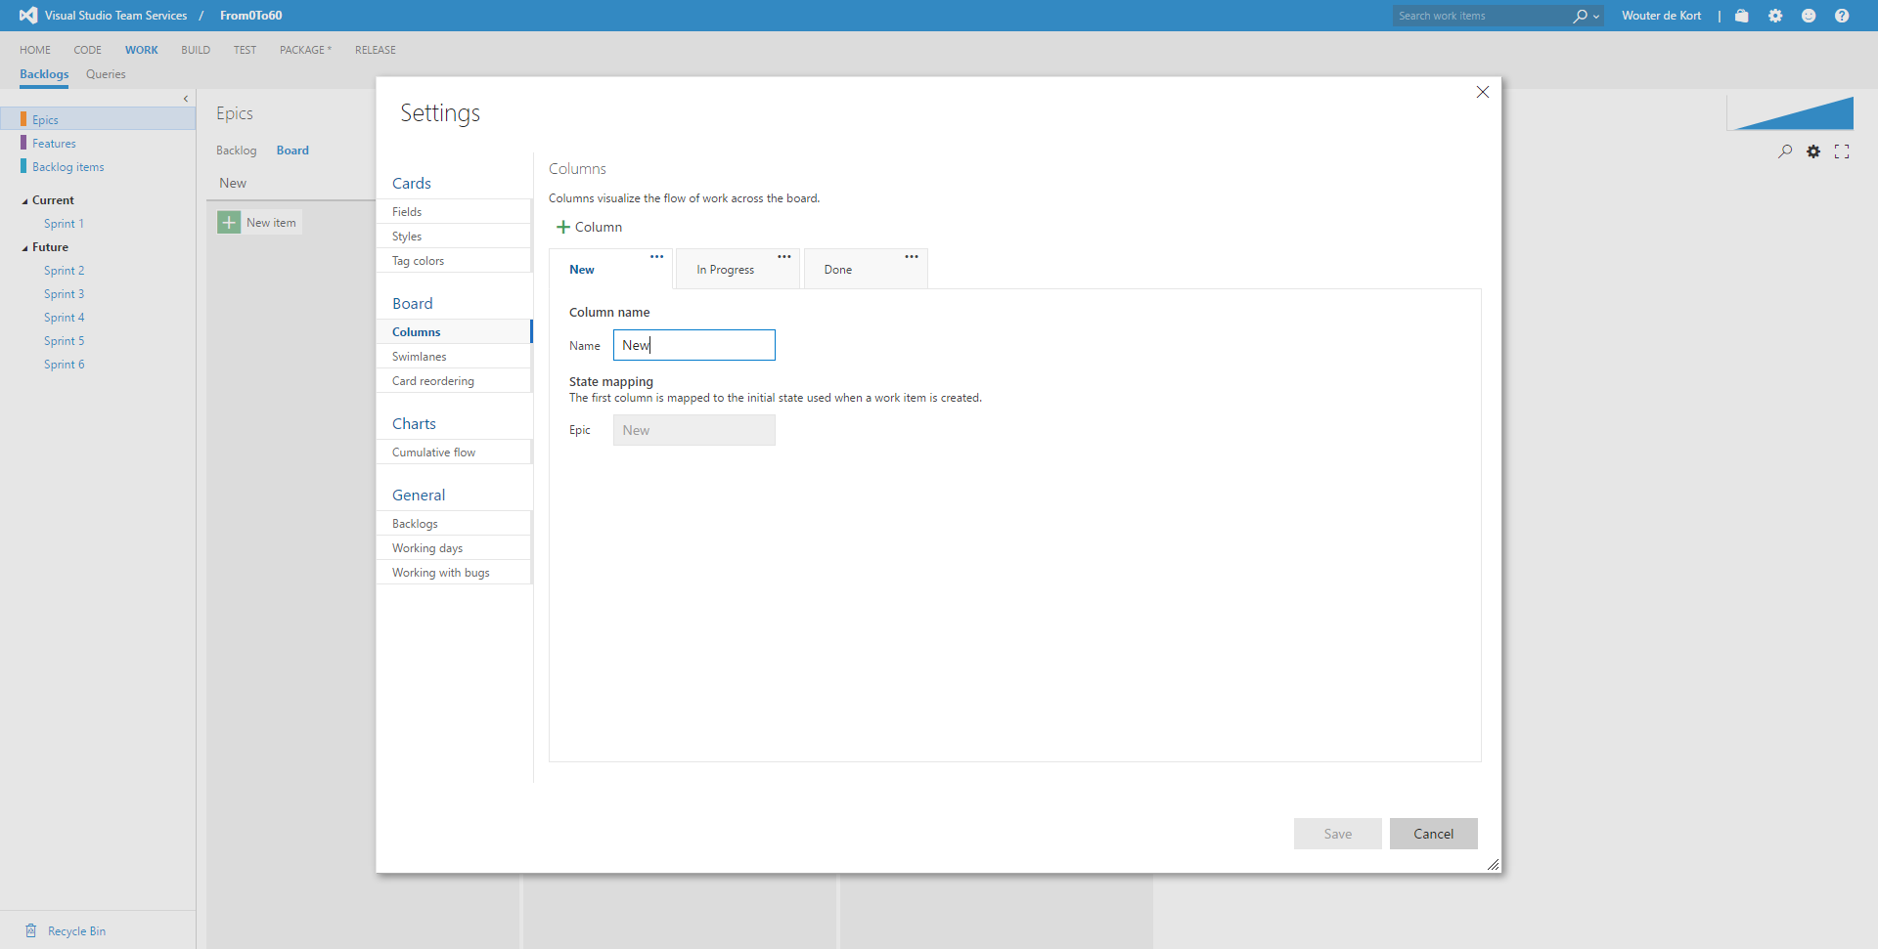

Slide 30
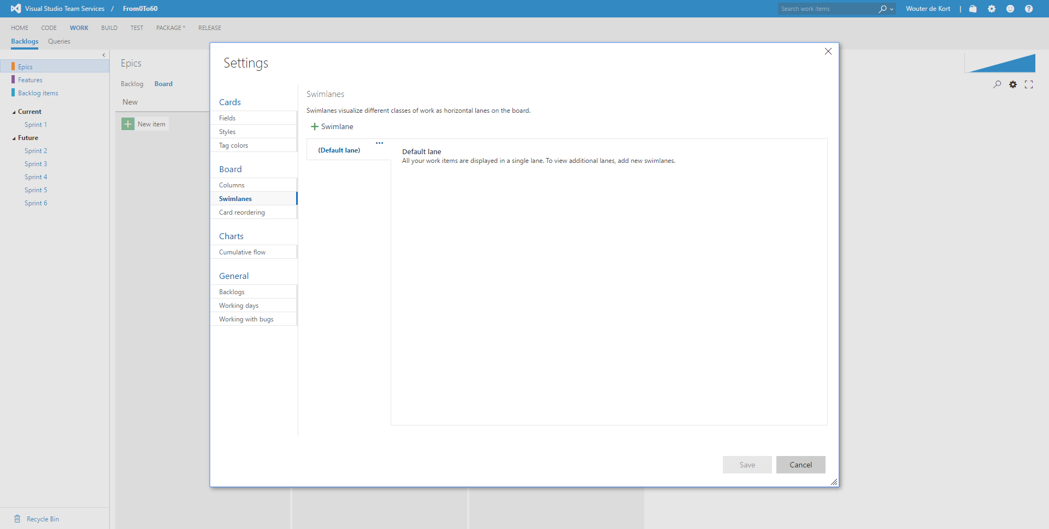

Slide 31
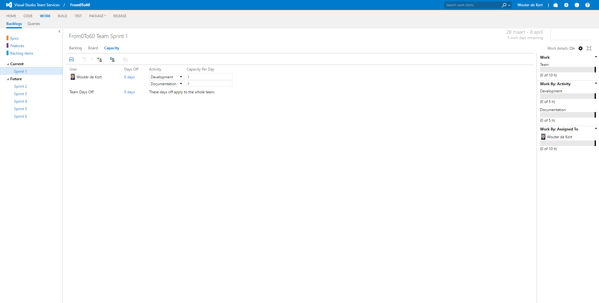

Slide 32
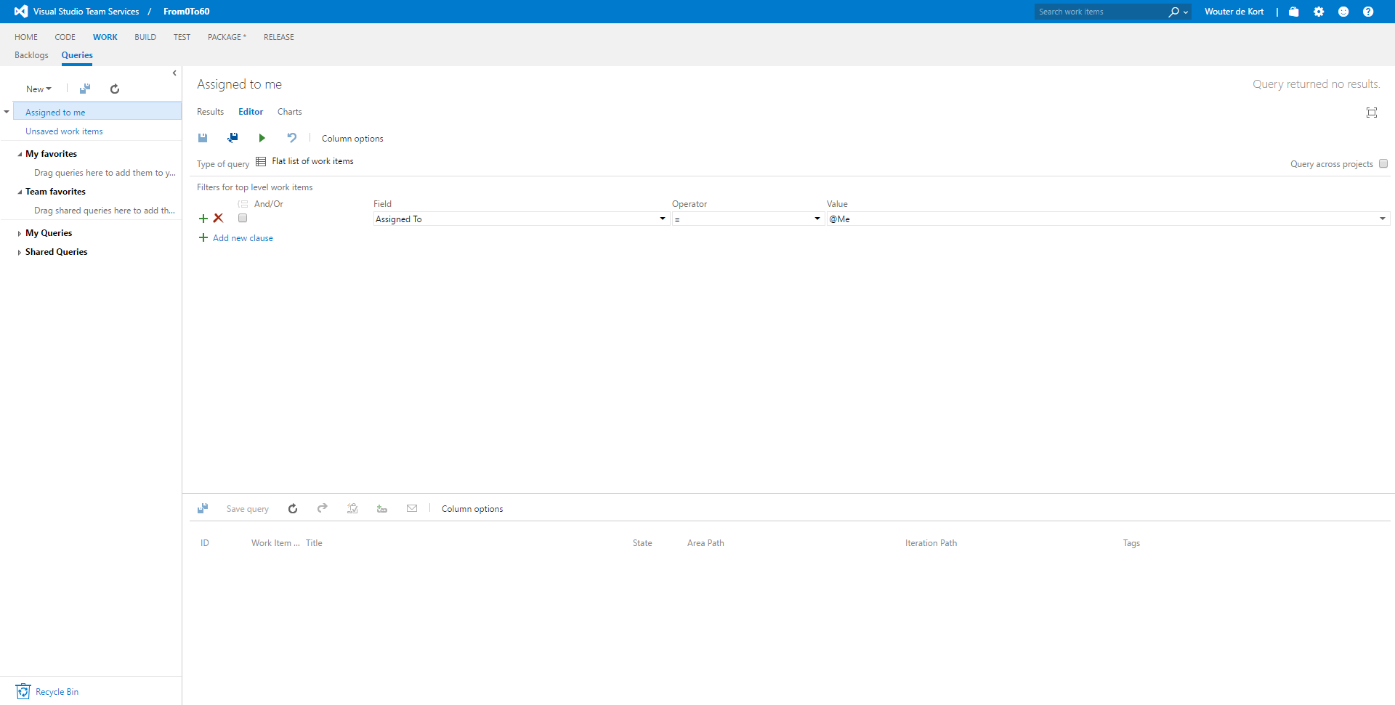

Slide 33
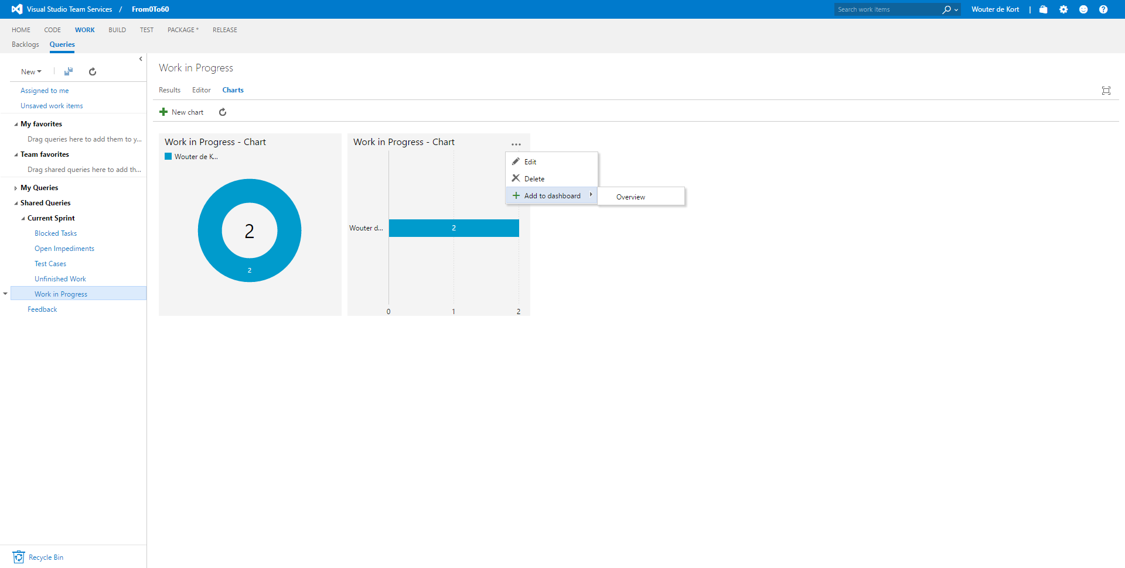

Slide 34
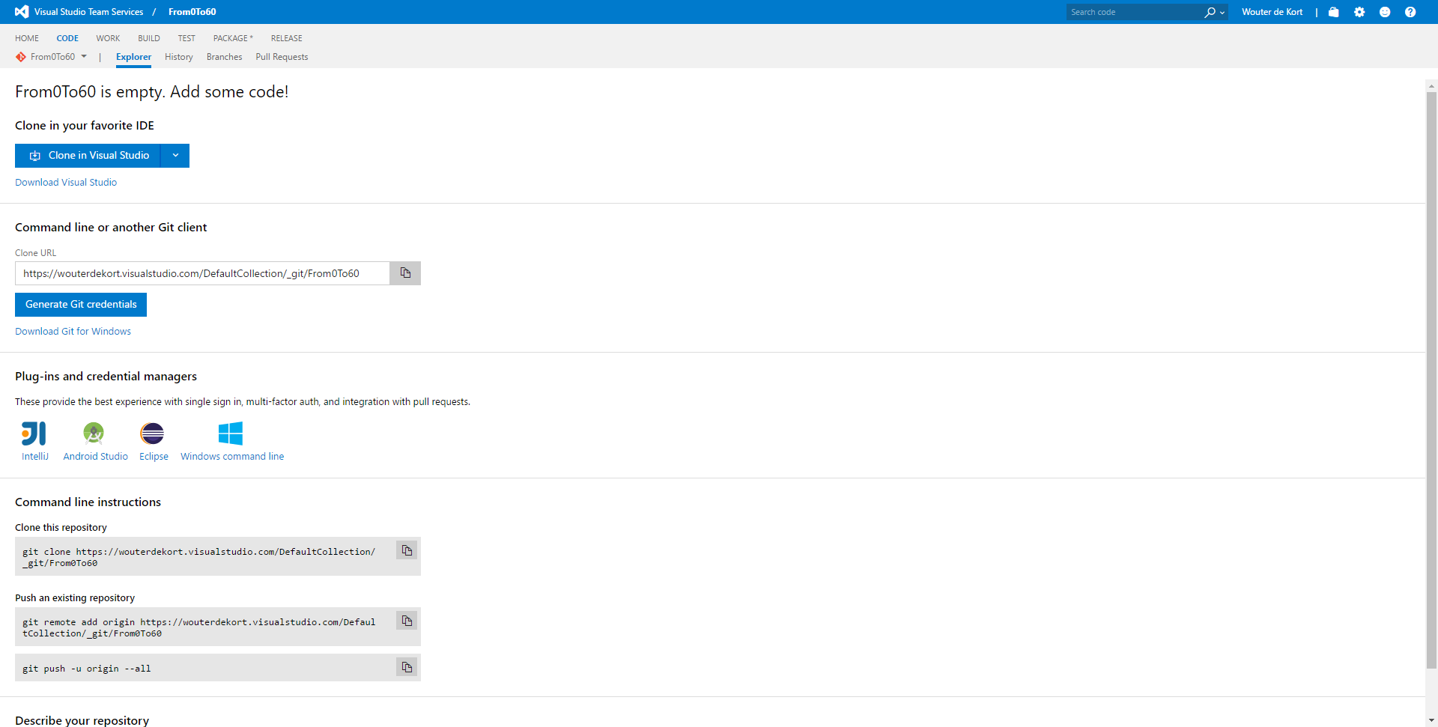

Slide 35
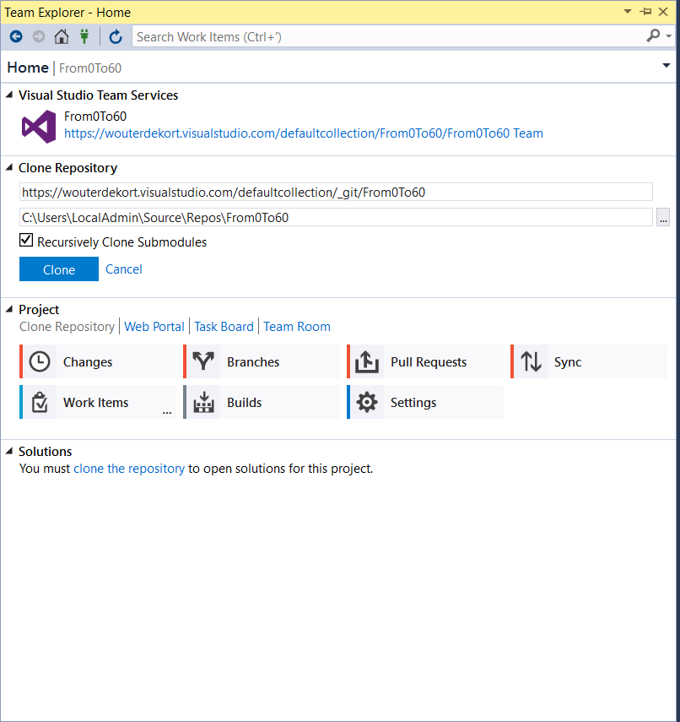

Slide 36
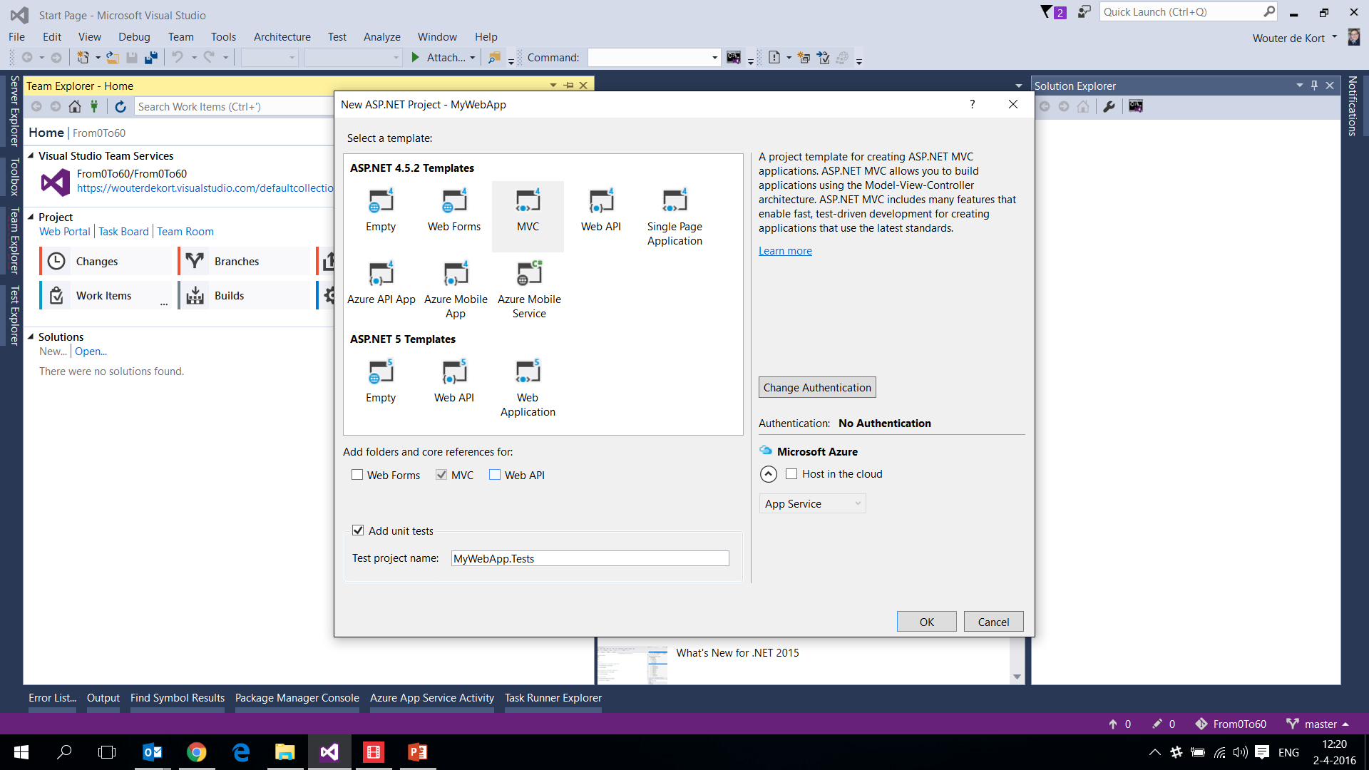

Slide 37
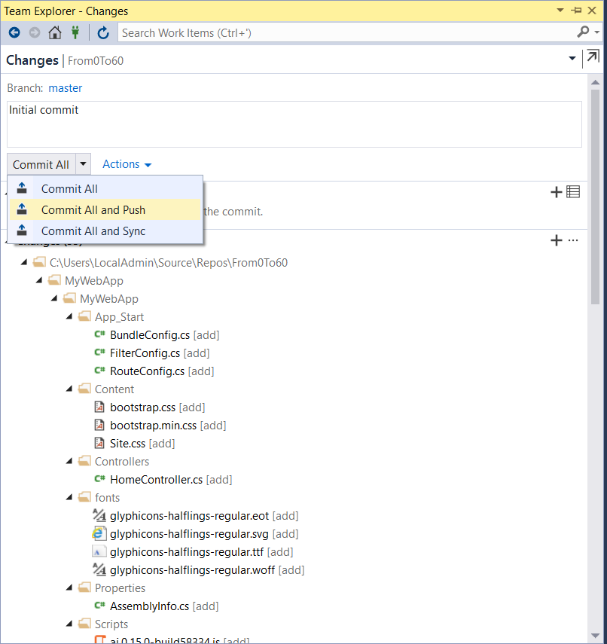

Slide 38
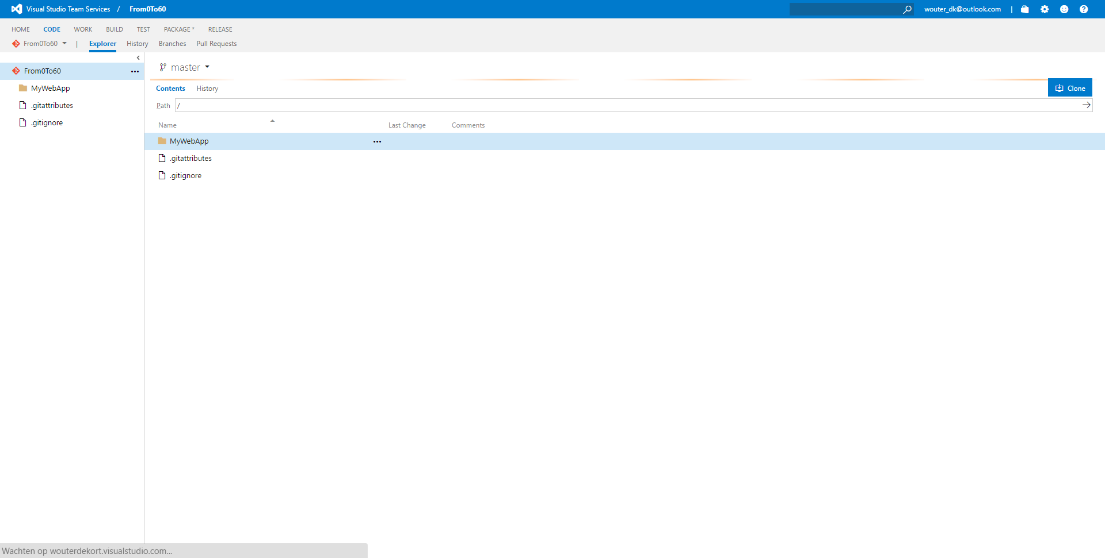

Slide 39
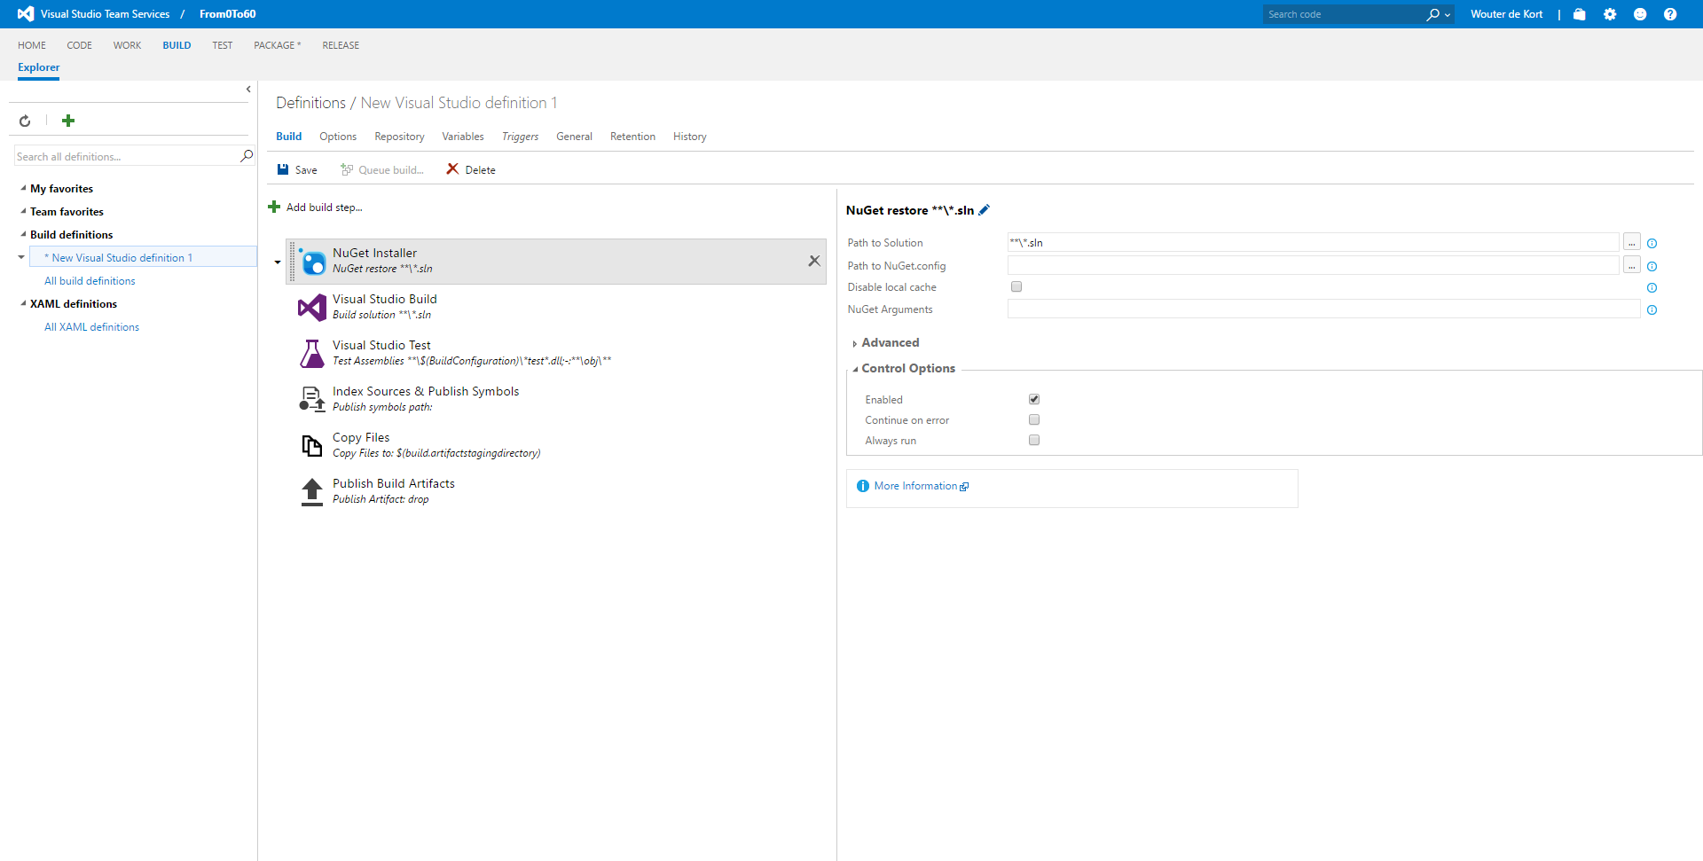

Slide 40
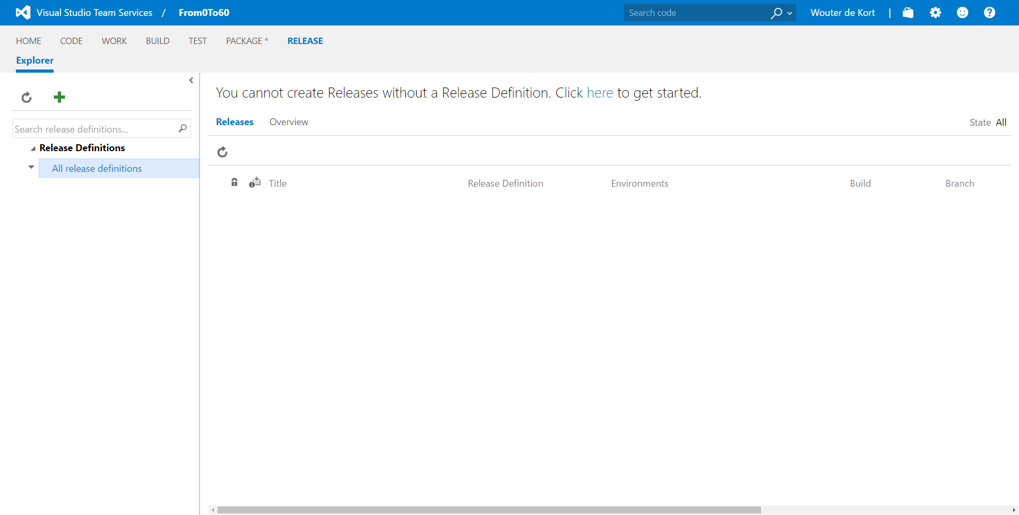

Slide 41
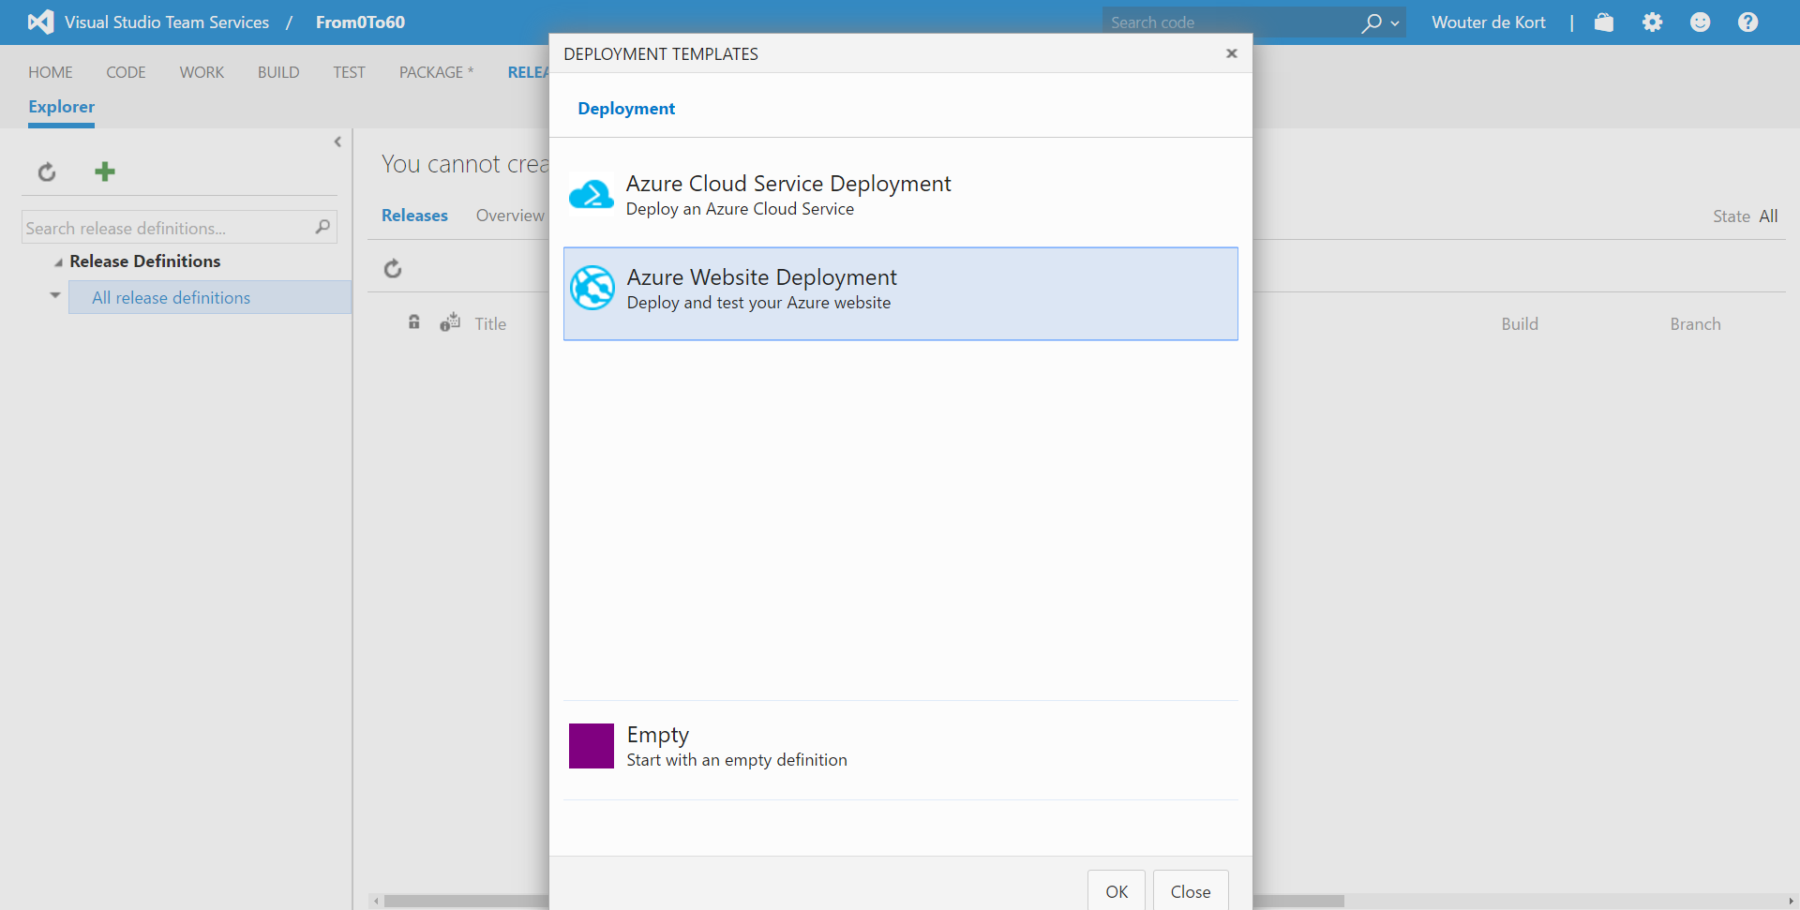

Slide 42
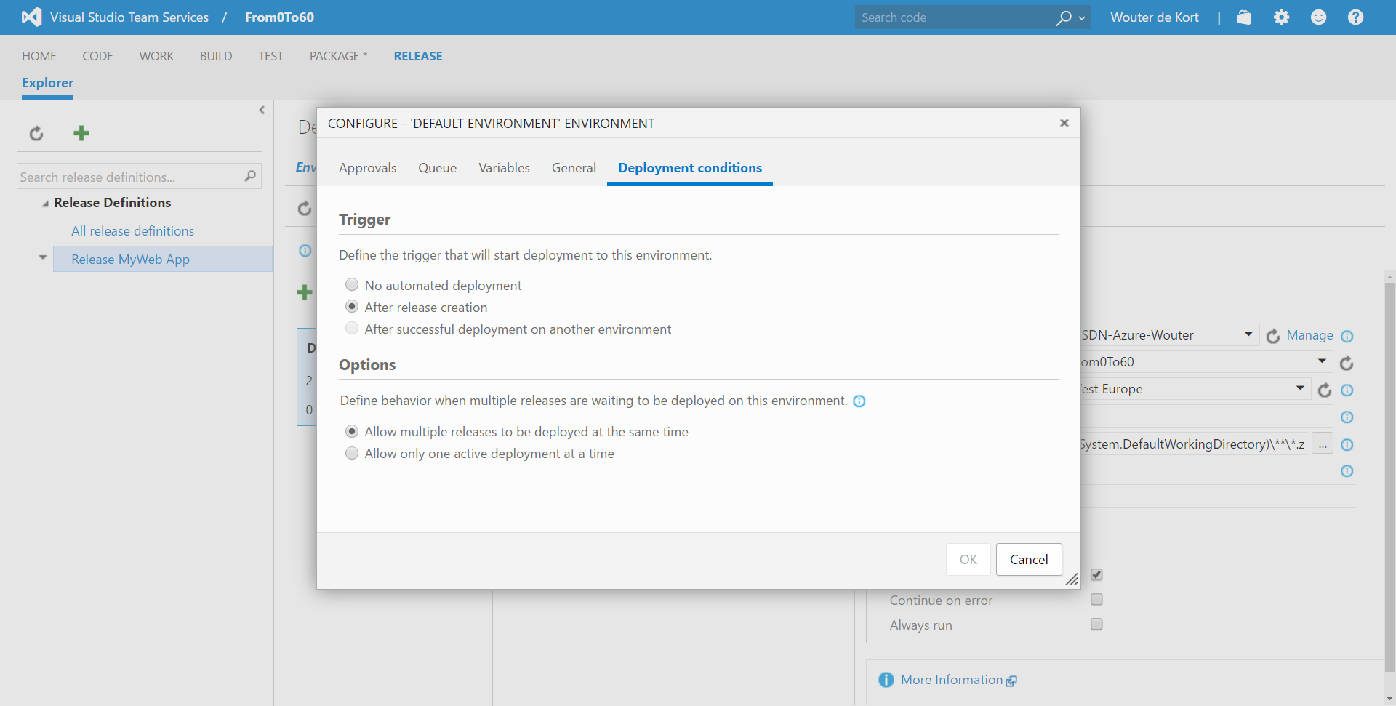

Slide 43
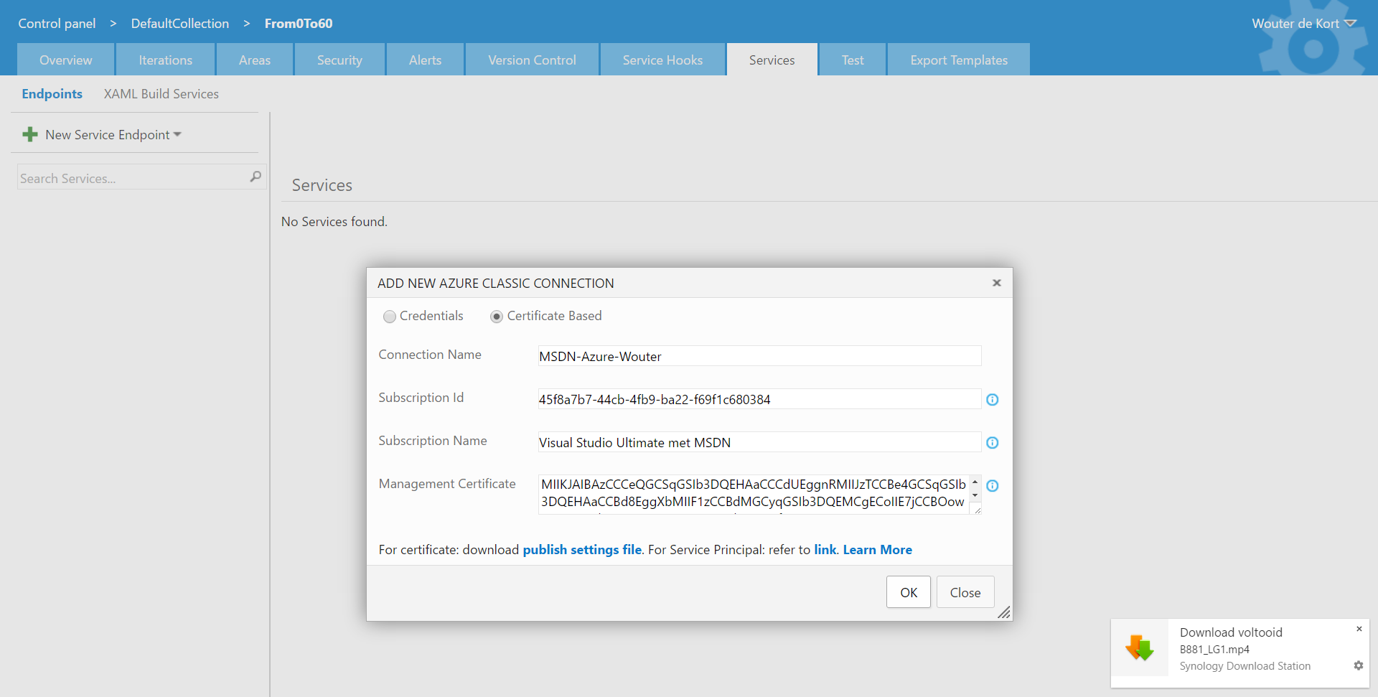

Slide 44
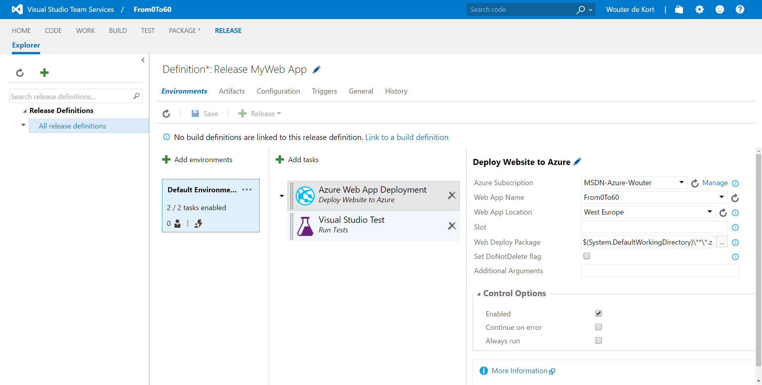

Slide 45
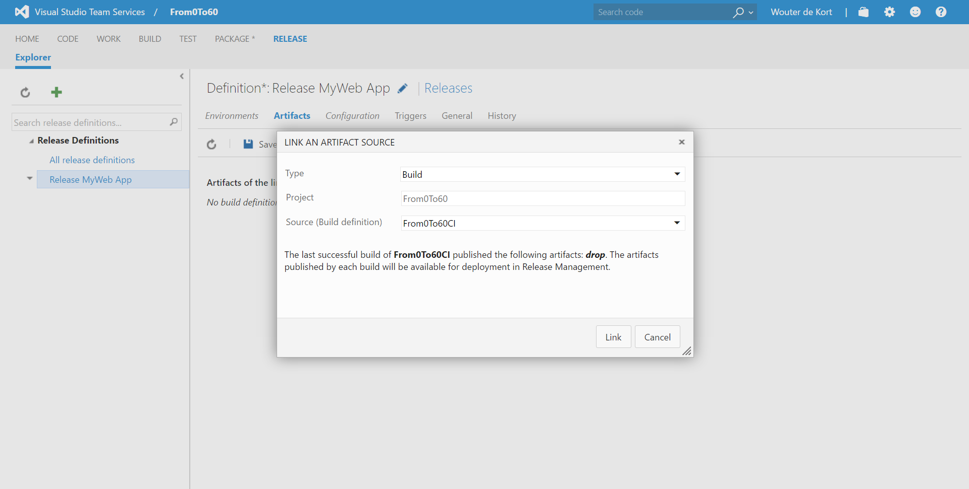

Slide 46
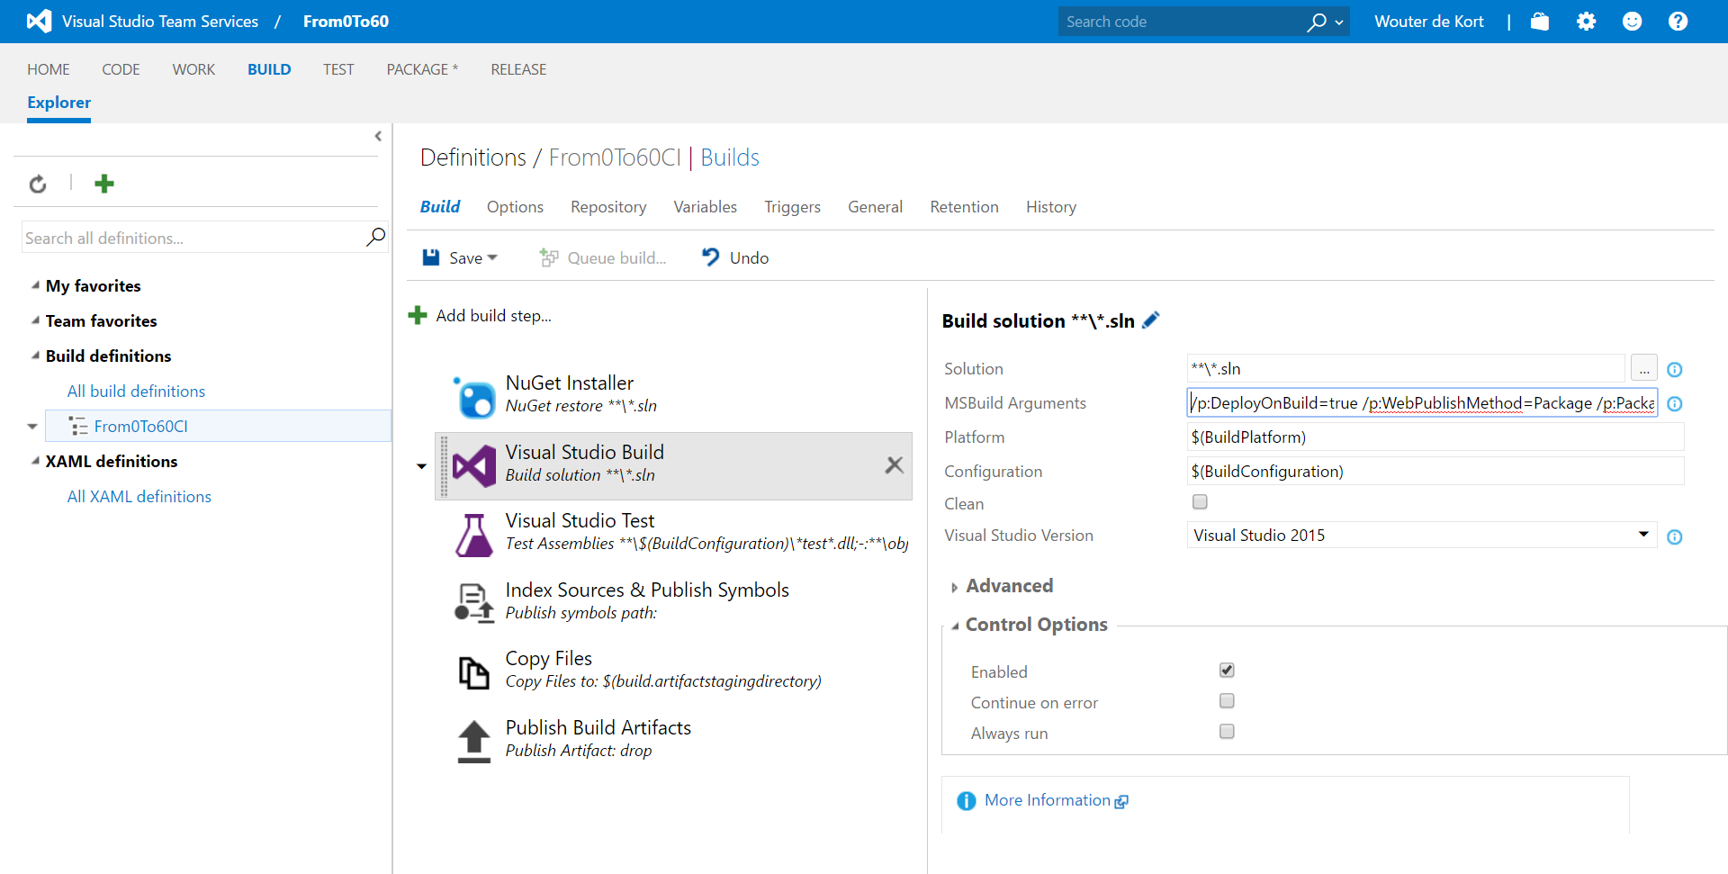

Slide 47
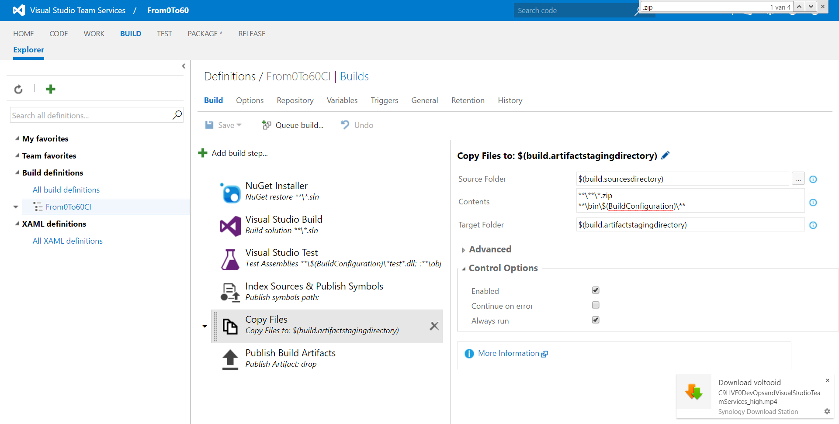

Slide 48
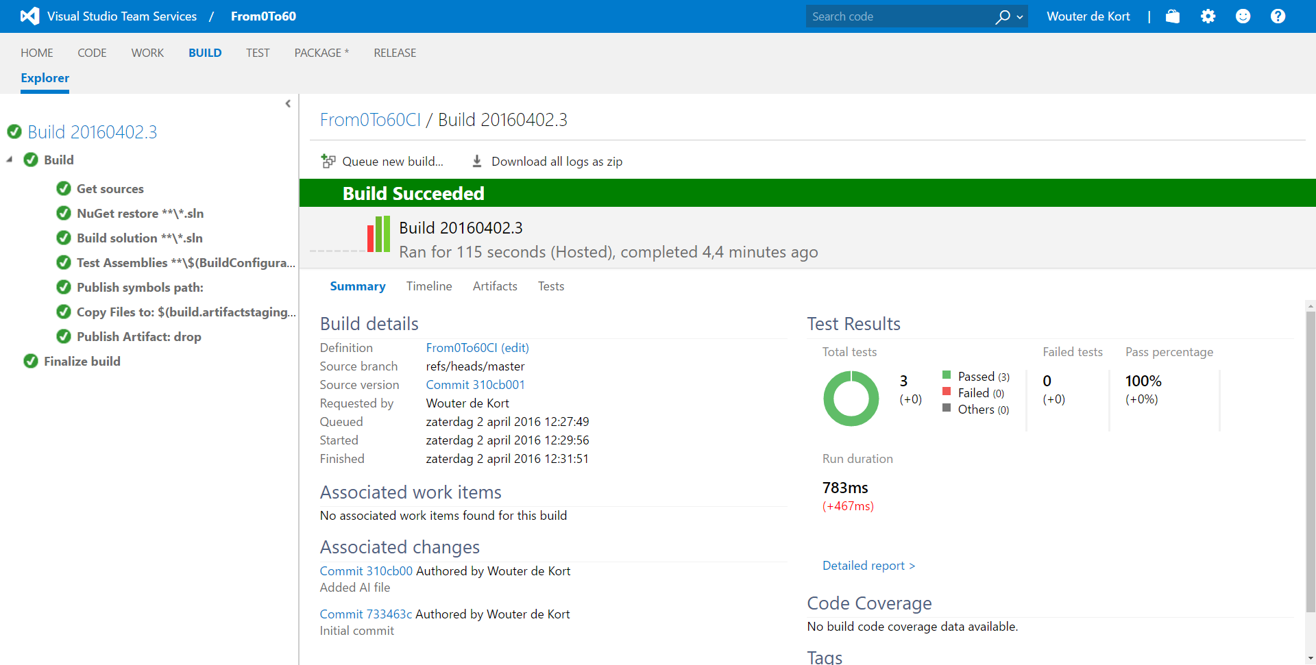

Slide 49
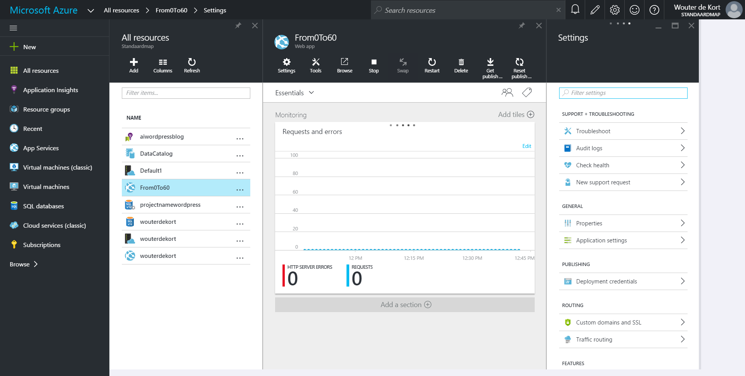

Slide 50
